Slide 1

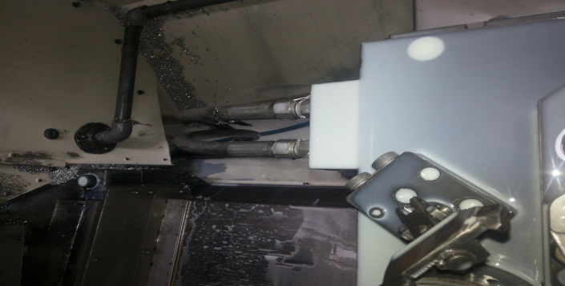

P15
TPM CIRCLE NO :- 01
ACTIVITY
KK
QM
PM
JH
SHE
OT
DM
E&T
KAIZEN IDEA SHEET
TPM CIRCLE NAME: Achiever
LOSS NO. / STEP
DEPT :- MACHINE SHOP
RESULT AREA
P
Q
A
B
C
D
S
M
CELL:- A105 FL WT
CELL NAME:- oil pump
MACHINE / STAGE :- DRILL MACHINE
OPERATION :- DRILLING
KAIZEN THEME: To identify clamping and de -clamping pipe
IDEA :-To used standard size Allen bolt for fixture setup
PROBLEM PRESENT STATUS – hydraulic pipe connect fixture that time getting difficulty in clamping and de-clamping pipe identified
COUNTERMEASURE:-
1. Difficult to identify clamping and de-clamping pipe so identification marking colour coding has to define
BENCHMARK
MINOR
TARGET
0
KAIZEN START
15.08.2016
TDC
26.08.2016
KAIZEN FINISH
26.08.2016
TEAM MEMBERS :KESHOR PAWAR,
MARUTI PATIL
BENEFITS :-
INCREASES PRODUCTIVITY
Before
After
KAIZEN SUSTENANCE
WHY - WHY ANALYSIS :-
Why1 :- No identification marking
Why2 :- no identification clamping and de-clamping pipe
Why3 :- minor stoppages for identification pipe
Why4 :- set up time increases
RESULT : Reduce set up time
WHAT TO DO:
HOW TO DO:-
FREQUENCY :- Daily.
SCOPE & PLAN FOR HORIZONTAL DEPLOYMENT
Sr No | CELL | TDC | RESP. | STATUS
1
2
ROOT CAUSE : Time saving
REGISTRATION NO. & DATE : 15.08.2016
REGISTERED BY :- Umesh pimple
MANAGER’S SIGN :- D Y . pawar
1
1

